Slide 1
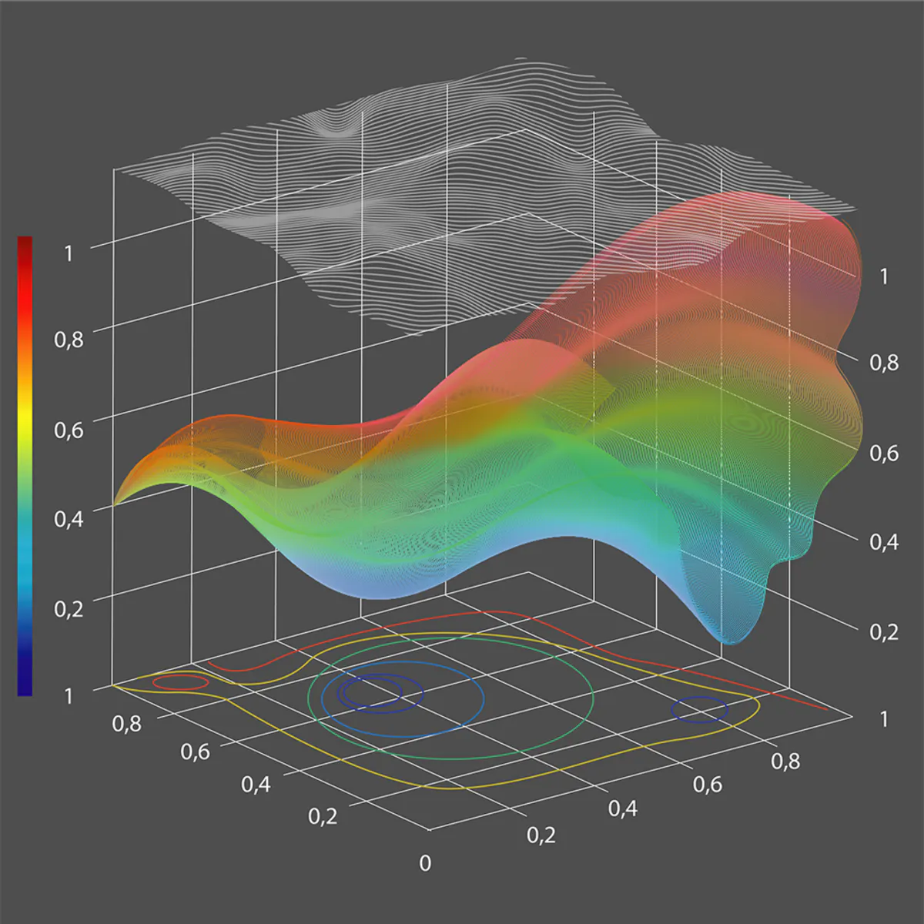
Error Analysis
Numerical Analysis

Slide 2
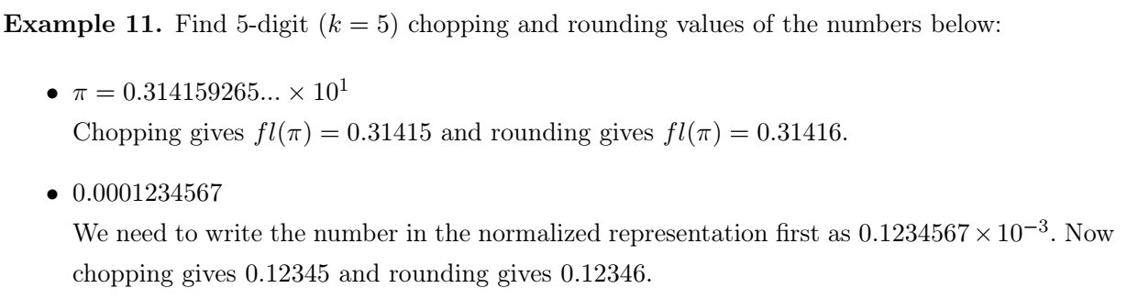

Chopping and Rounding
Take the first k digits and ignore the rest: $fl\left(x\right)= 0.d_{1}d_{2}…d_{k}$
If $d_{k}+1 ≥ 5$we add $1$ to $d_{k}$ to obtain $fl\left(x\right)= If d_{k}+1 < 5$; then we simply do as in chopping

Slide 3
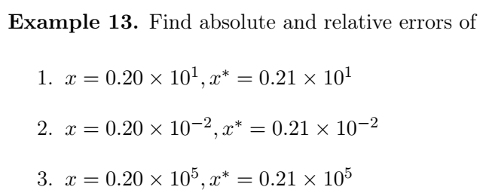



Absolute Error (AE) and Relative Error (RE)
Absolute Error (AE):It is difference between measured value $x^{∗}$ and actual value $x$ then its absolute value is reported
Relative Error (RE): the size of error with respect to actual value.
$$AE=\left|x^{∗}−x \right|$$
$$RE=\frac{\left|x^{∗}−x \right|}{\left|x\right|}$$

Slide 4
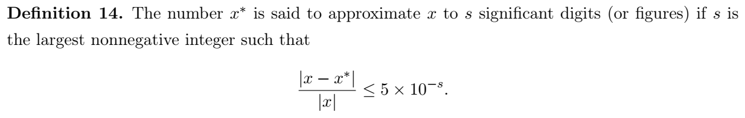
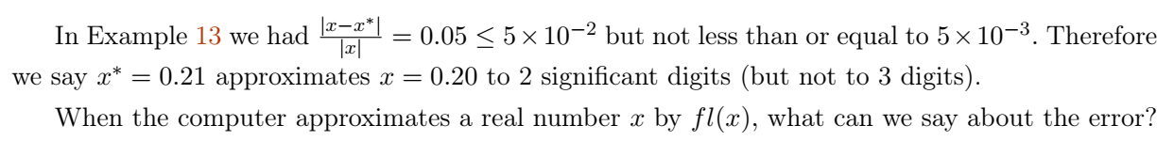

Slide 5
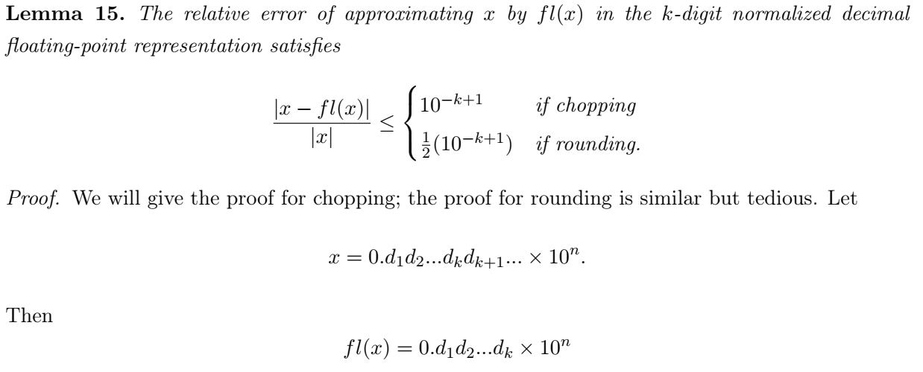
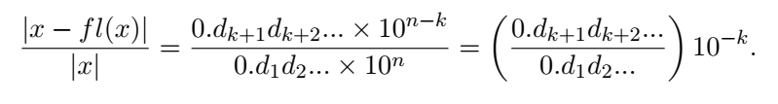
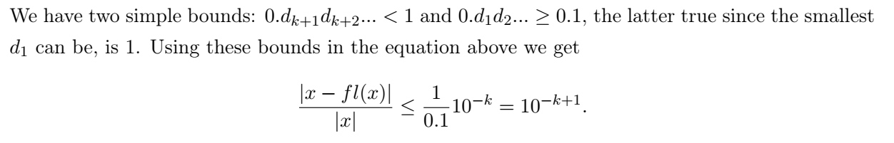

Slide 6
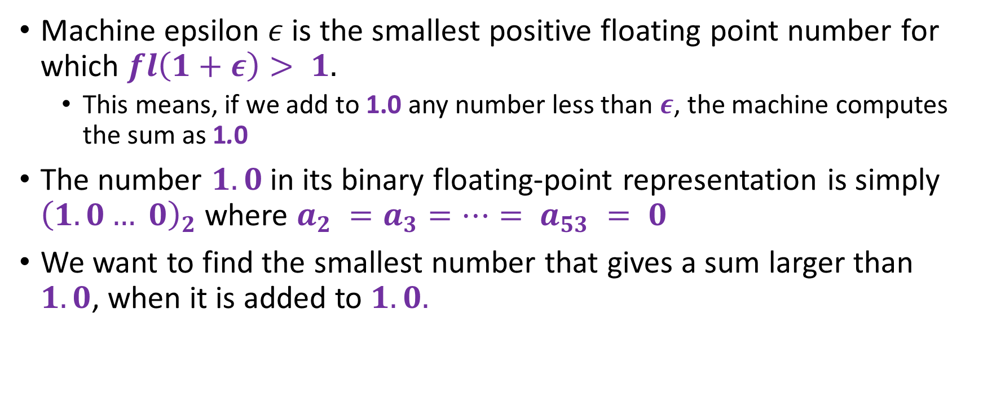
Machine epsilon
Machine epsilon $ε$ is the smallest positive floating point number for which $fl\left(1+ε\right)> 1.$
This means, if we add to 1.0 any number less than $ε$, the machine computes the sum as 1.0
The number $1.0$ in its binary floating-point representation is simply ${\left(1.0… 0\right)}_{2}$where $a_{2} =a_{3}=…= a_{53} = 0$
We want to find the smallest number that gives a sum larger than $1.0$, when it is added to $1.0.$

Slide 7
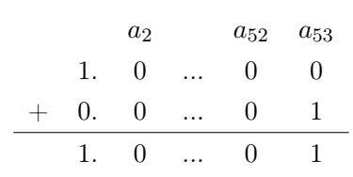
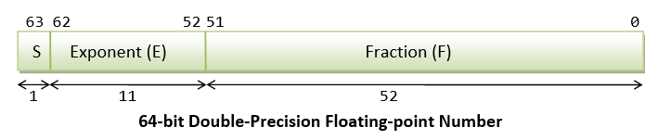
Machine Epsilon - Chopping

Slide 8
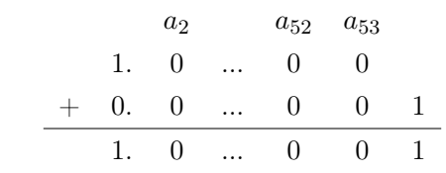
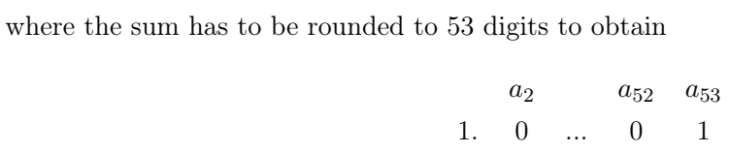
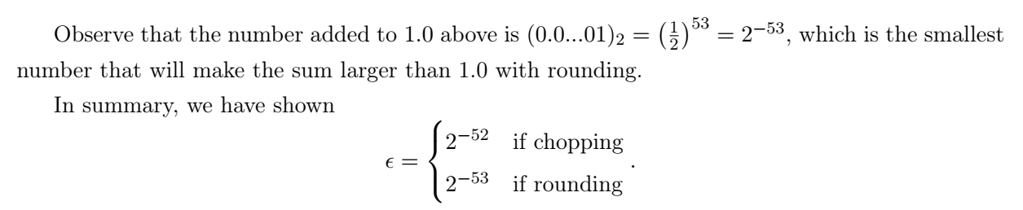

Machine epsilon - rounding

Slide 9
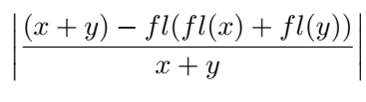
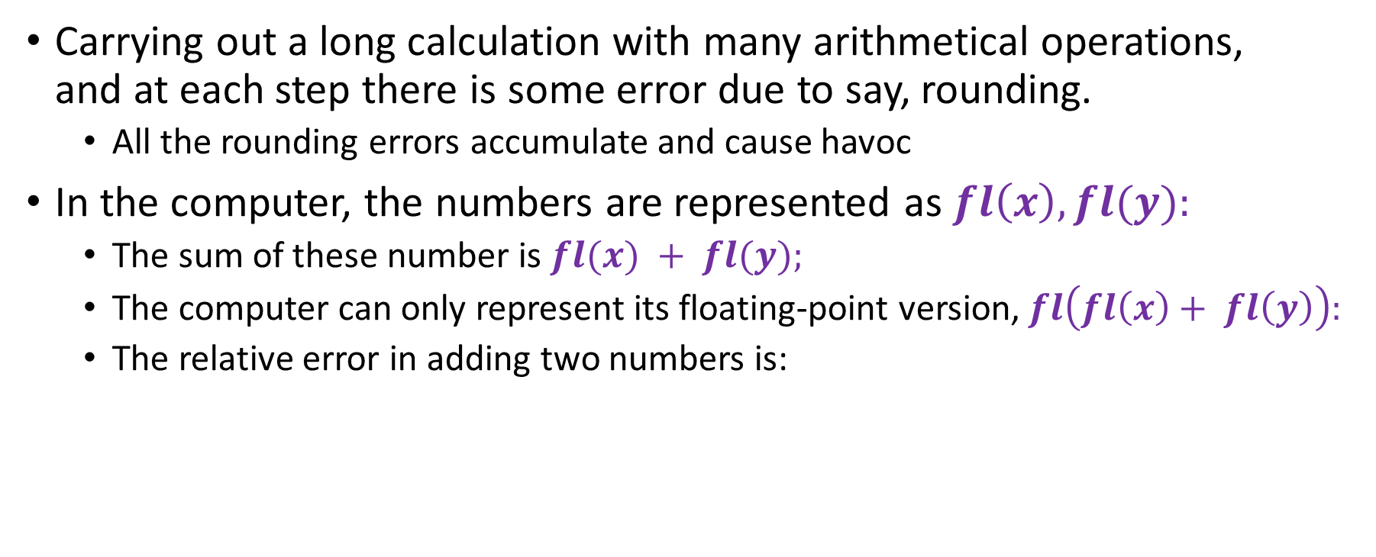
Error Propagation
Carrying out a long calculation with many arithmetical operations, and at each step there is some error due to say, rounding.
All the rounding errors accumulate and cause havoc
In the computer, the numbers are represented as $fl\left(x\right), fl(y):$
The sum of these number is $fl(x) + fl(y);$
The computer can only represent its floating-point version, $fl\left(fl\left(x\right)+ fl\left(y\right)\right):$
The relative error in adding two numbers is:

Slide 10
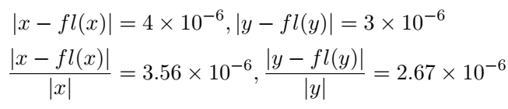
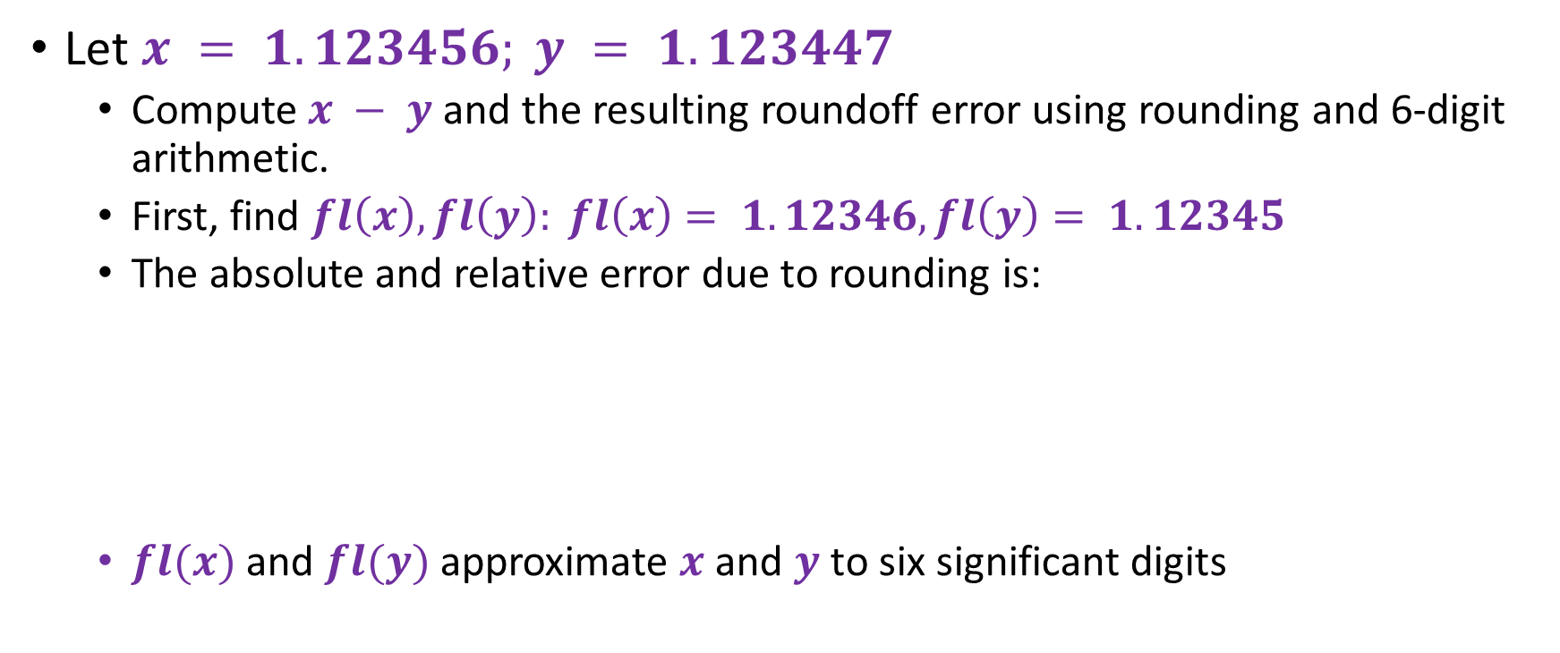
Subtraction of nearly equal quantities: Cancellation of leading digits
Let $x = 1.123456; y = 1.123447$
Compute $x − y$and the resulting roundoff error using rounding and 6-digit arithmetic.
First, find $fl\left(x\right), fl\left(y\right): fl\left(x\right)= 1.12346, fl\left(y\right)= 1.12345$
The absolute and relative error due to rounding is:
$fl(x)$ and $fl(y)$ approximate $x$ and $y$to six significant digits

Slide 11
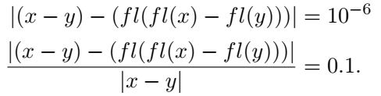
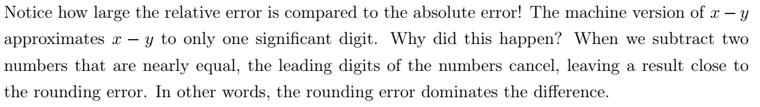
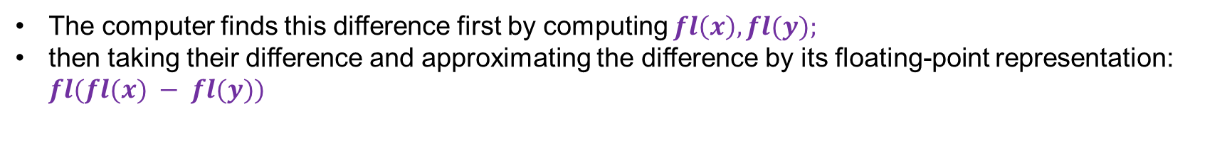
The computer finds this difference first by computing $fl\left(x\right), fl(y);$
then taking their difference and approximating the difference by its floating-point representation: $fl(fl(x) − fl(y))$

Slide 12
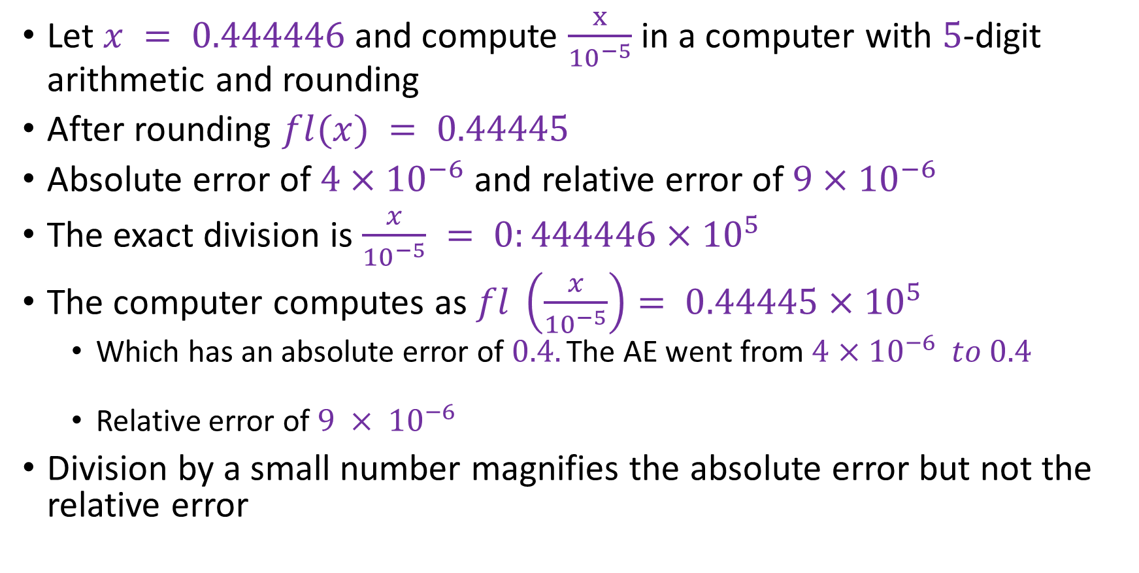
Error Example
Let $x = 0.444446$and compute $\frac{x}{{10}^{−5}}$ in a computer with $5$-digit arithmetic and rounding
After rounding $fl(x) = 0.44445$
Absolute error of $4×{10}^{−6}$ and relative error of $9×{10}^{−6}$
The exact division is $\frac{x}{{10}^{−5}} = 0:444446×{10}^{5}$
The computer computes as $fl \left(\frac{x}{{10}^{−5}}\right)= 0.44445×{10}^{5}$
Which has an absolute error of $0.4.\text{The} \text{AE} \text{went} \text{from} 4×{10}^{−6} to 0.4$
Relative error of $9 × {10}^{−6}$
Division by a small number magnifies the absolute error but not the relative error

Slide 13
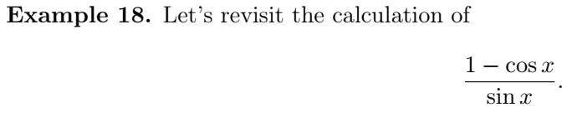
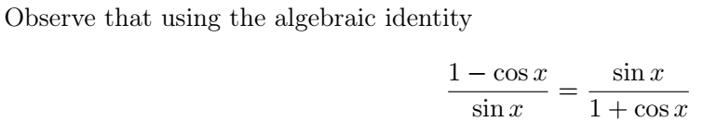
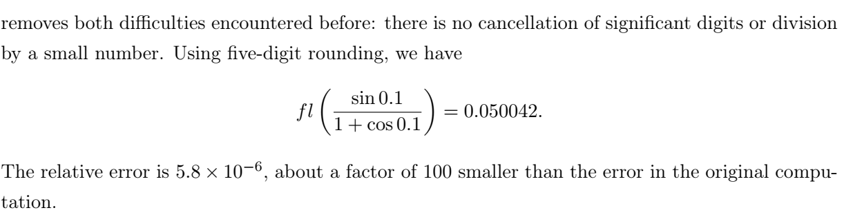
How to avoid loss of accuracy

Slide 14

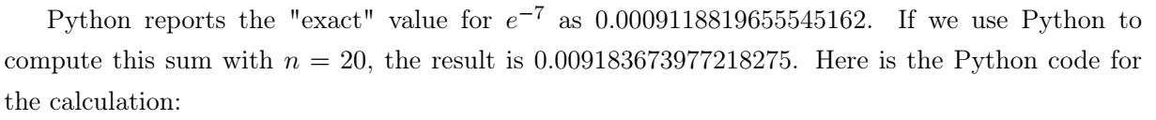

Python error example
This result has a relative error of $9.1$.
We can avoid this huge error if we simply rewrite the above sum as

Slide 15
Sources of error in applied mathematics
Error due to the simplifying assumptions made in the development of a mathematical model for the physical problem
Programming errors
Uncertainty in physical data: error in collecting and measuring data
Machine errors: rounding/ chopping, underflow, overflow, etc
Mathematical truncation error: error that results from the use of numerical methods in solving a problem, such as evaluating a series by a finite sum, a definite integral by a numerical integration method, solving a differential equation by a numerical method

